Slide 1
Problem Statement:
Face Re - Identification
Karri Sai Charan

Slide 2
Overview
Transfer Learning
VGG - 16 with 4 Layers added
Input Data
Feature Vector
Cosine Similarity
New Test Data

Slide 3
Overview Visualization

Slide 4
Dataset Preparation

Slide 5
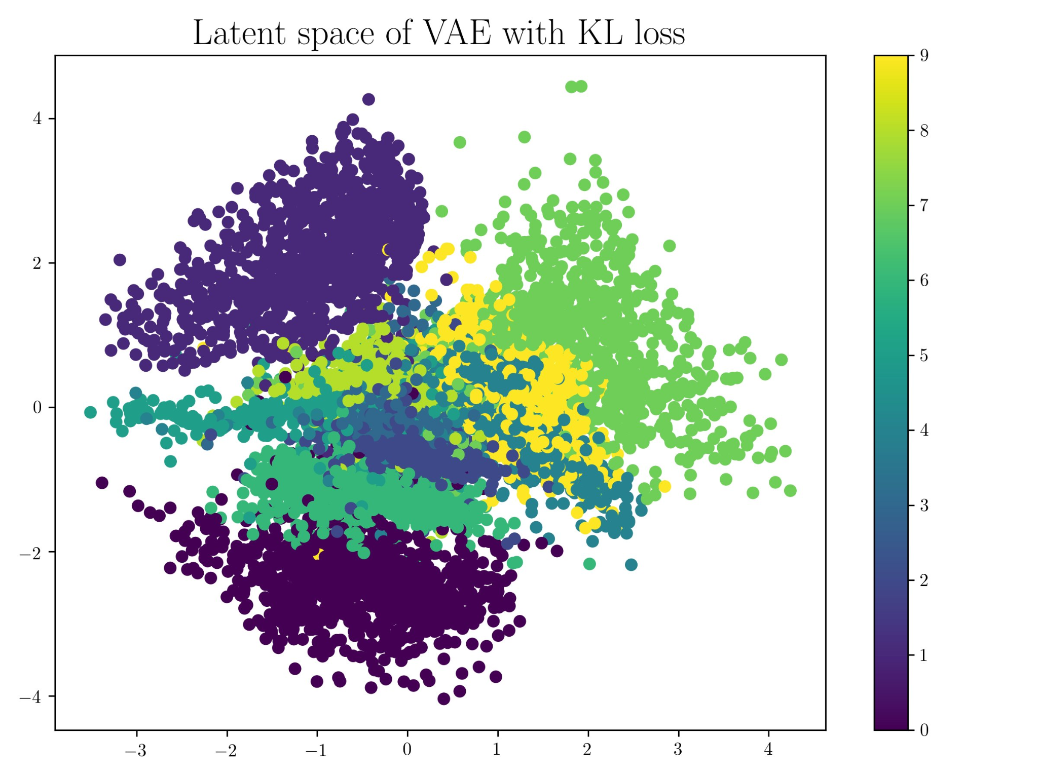
Visualizing Extracted Features from the new layer
Feature Vectors
Feature Vectors
Feature space in 2D
Feature space in 3D

Slide 6
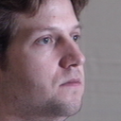
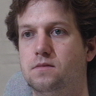

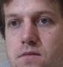
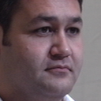
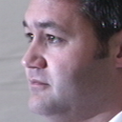
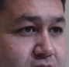
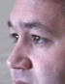
Feature Engineering
Make new Data
( Features )
Input Data
Yolo wt file
Train Data

Slide 7
Need for Feature Engineering
Feature Vectors
Feature Vectors
Feature space in 2D
Feature space in 2D

Slide 8
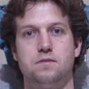
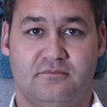
Dataset Information
Images used
Dataset Information:
Number of Classes = 2
Number of Augmentations = 9
Total samples per class = 4000
Train samples = 2800 * 2 = 5600
Test samples = 400 * 2 = 800
Val samples = 800 * 2 = 1600
Augmentations :
Gaussian Blur,
Brightness,
Contrast,
Rotate,
Noise,
Resize,
Gray,
Sharp,
Vignette
Class A
Class B
Epochs 4 |  | Train | Test | Val
 | Accuracy | 0.9945 | 0.9937 | 0.9900
 | Loss | 0.0218 | 0.0211 | 0.0316

Slide 9
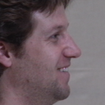
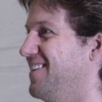
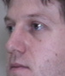
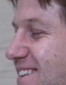
Test Results before and after Feature Engineering
Before Feature Engineering
After Feature Engineering
Class : A Test | Cosine Value
A test vs A Master | 0.8367
A test vs A Master | 0.3707
Class A | Cosine Value
A test vs A Master | 0.9992
A test vs A Master | 0.9992
A test vs A Master | 0.9976

Slide 10
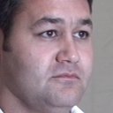
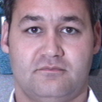
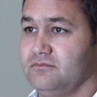
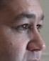
Test Results before and after Feature Engineering
Before Feature Engineering
After Feature Engineering
Class : B Test | Cosine Value
B test vs B Master | 0.2886
B test vs B Master | 0.2926
B test vs B Master | 0.3007
Class B | Cosine Value
B Test vs B Master | 0.9895
B Test vs B Master | 0.9969
B Test vs B Master | 0.9961

Slide 11
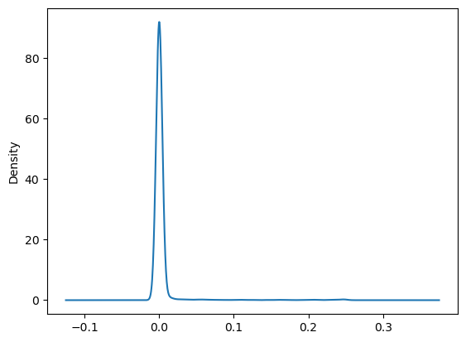
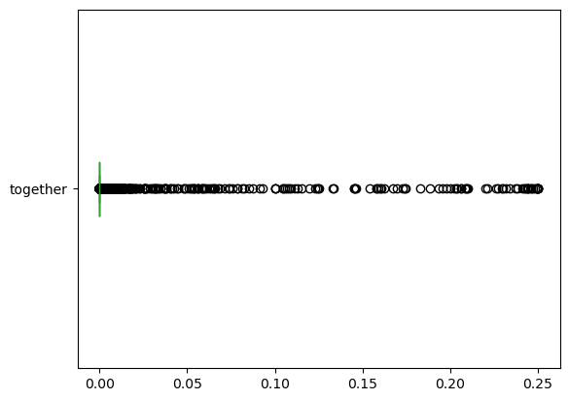
Further Approaches that are under testing
Normalizing the Skewness of the Feature Vector
Treating Outliers
Train Data Feature Vector
Skewness = 8.3671 ( Heavily Positively Skewed )

Slide 12
Impact of Skewness and Kurtosis
'Skewness' and 'Kurtosis' - Metrics for understanding the Data distribution :
Skewness : It is the Measure of Asymmetry of the Curve
If the skewness is between -0.5 & 0.5, the data are nearly symmetrical.
If the skewness is between -1 & -0.5 (negative skewed) or between 0.5 & 1(positive skewed), the data are slightly skewed.
If the skewness is lower than -1 (negative skewed) or greater than 1 (positive skewed), the data are extremely skewed.
Kurtosis : The height of the Distribution Curve with respect to Normal Distribution
It tells us if the data is heavy or light tailed relative to a normal distribution.
Kurtosis range from -10 to +10.

Slide 13
Need for Normalizing Feature Vector
Normalization helps to scale the values of the features to a common range, which can improve the performance of the face re-identification model by making the features more comparable.
This is important because different images may have different lighting conditions, poses, and resolutions, which can affect the values of the features.
Normalization can help to remove these variations and make the features more consistent across different images.

Slide 14
Normalizing Feature Vector
Skewness (-0.5 to 0.5)
Transformations | Original | 1 | 2 | 3 | 4 | 5
Train | 8.3671 | 6.2898 | 4.0097 | 2.0226 | 0.7310 | -0.2475
Test | 1.0893 | 1.0603 | 1.0165 | 0.8799 | 0.5509 | 0.0437
Validation | 6.8188 | 5.2946 | 3.6805 | 2.0190 | 0.7406 | -0.2909
Kurtosis (-10 to 10)
Transformations | Original | 1 | 2 | 3 | 4 | 5
Train | 73.7831 | 42.3855 | 17.8650 | 4.4043 | 0.0719 | -0.2387
Test | -0.7930 | -0.8551 | -0.9261 | -1.0756 | -1.3054 | -1.2522
Validation | 48.73 | 28.9957 | 14.1310 | 4.1429 | 0.1255 | -0.1320

Slide 15
Discussion on how project goes further
Transfer Learning
VGG - 16 with 4 Layers added
Normalize FV
Input Data
Feature Vector
Feature Engineering with YOLOv5
Cosine Similarity
New Test Data

Slide 16
Dataset Preparation
Head Level Captured Images
Great Quality of Images ( No Blur Data should be used )
Dataset covering 360 degrees of the person
Generate a new YOLOv5 weight file that captures only facial features such as eyes, nose, cheeks and mouth.
First Augmentation = Mirror Image, then the rest augmentations can be performed

Slide 17
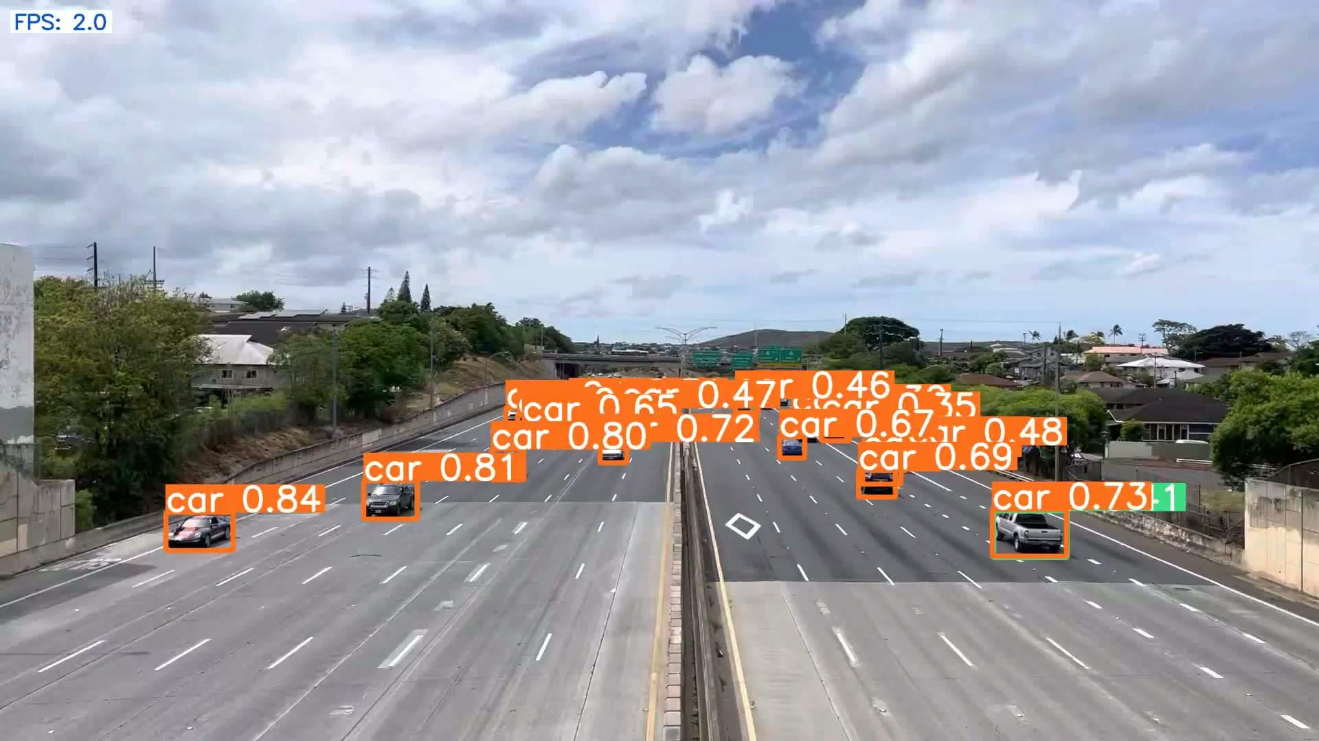
Challenges

Slide 18
THANK YOU

